Slide 1
BRAINCO Collaboration

Slide 2
BrainCo Collaboration
Invited by Ray Niehaus
Perry Central High School
MIT and Harvard joint project
IOT Lab in Fishers IN

Slide 3
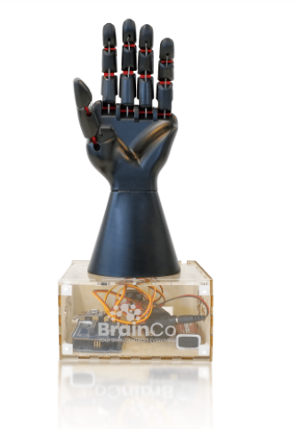
What is BrainCo
BrainCo STEM Hand Base Set Includes:
All Ready-to-Build Hardware
Motors, Controllers, Sensors, IR Remote, Cables and more
Full Curriculum Access
Block Based Programming Platform or
Python Based Programming
This is the base for testing and integrating with the other devices

Slide 4
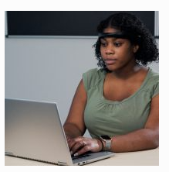
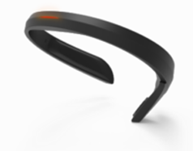
NeuroMaker
NeuroMaker BCI utilizes high tech, safe EEG hardware that detects and digitizes brain activity for analysis and data science applications.
This is for developing control over the bionics with brain waves

Slide 5
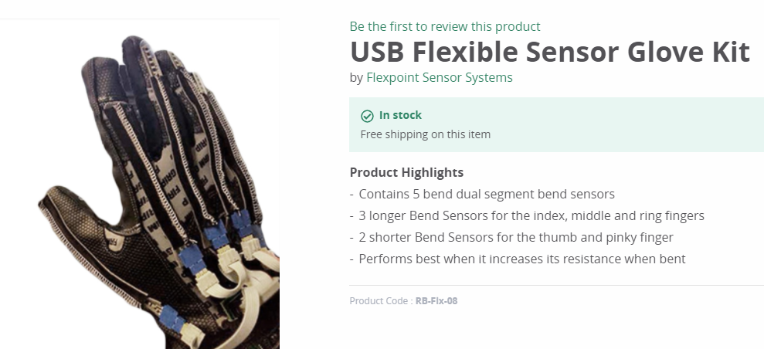
This is for controlling the hand with gestures

Slide 6
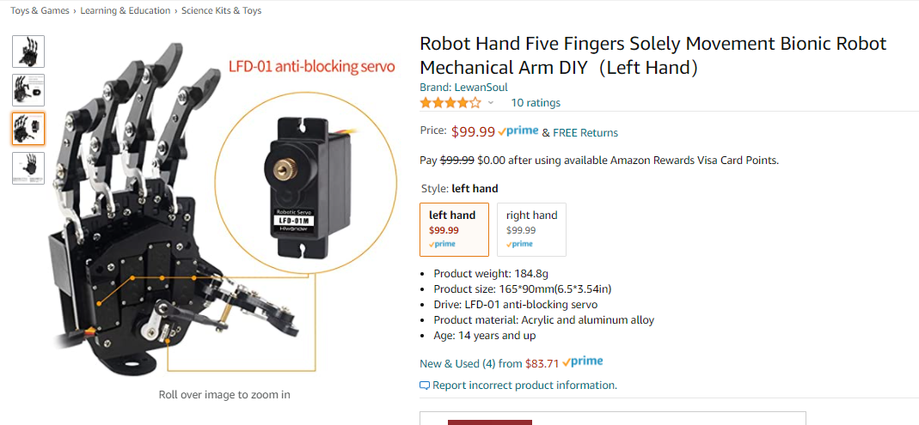
This is for testing the use of servo motors and linkages on fingers

Slide 7
What is our role?
Automate a wrist for this hand
Test piezo and other sensors
Experiment with feedback to user
Tie into e-NABLE open-source prosthetics
Tie into NIOP catalog of offerings

Slide 8
Who and When
Students and community partners will start meeting right away to develop a plan.
This summer will have virtual or face-to-face meetings to test these parts. Older students from previous camps will be invited. There will be no additional cost for these “inventor camps”.
The team will collaborate with Ray Niehaus and his connections to share information and progress.

Slide 9
What is in it for us?
Ties in with our AART and Design Curriculum
Robotics Club – Students from all majors
Summer “inventors” camp – Socially distant work possible
Community collaboration
A showy demonstration of our work
Two robots with hands interacting
Pouring liquid without spilling
Picking up an egg
Passing an egg to another robot

Slide 10
Deliverables
By the end of the summer we will deliver:
A mechanized wrist that can operate with one or more prosthetic hands.
The ability for students to run the BrainCo and Mechanical hands.
Test results from the NeuroMaker, Sensor Glove, and other sensor control options.
The possibility to do demonstrations and hands-on activities that can amaze and inspire.
Data and design information to share with the e-NABLE and other open-source communities.

Slide 11
What else could we do?
Wellness Center - biofeedback
Area Hospitals – neurology, biotech
Service hours for high school students

Slide 12
What do we need?
BrainCo Hands – 2 at $500 ea
One NeuroMaker BCI – 1 at $500 ea
Upgrade to Objet30 printer (covered under Perkins funds) -$15,000
3D printing filament/laserable plastic – $250
Sensors/Arduino parts – $500
Mechanical hand – 2 at $100 ea
Mechanical parts – $475
Snacks to keep students happy – $70
Total request: $2,995

